Slide 1
Enhancing Efficiency of news classification for Health Literacy System

Slide 2

Data scientist team
Department of Disease Control, Ministry of Public Health.
Notes:
I am a data scientist team member from ……. Who is assigned to increase the efficiency of the literacy system in Phase 1.

Slide 3
Target audience
Web administrator
Development team
Project Owner
A team in charge of data in the system and coordinates with relevant internal departments.
A team is responsible for website development project from end to end.
A team in charge of initiating the project's scope, objectives and requirements.
Notes:
My Today Target audience are Web administrator A team in charge of managing data in this system, Development team who is responsible for website development project from end to end and Project Owner who is initiating the project's scope, objectives and requirements.

Slide 4
Table of contents
01
02
03
04
05
06
Background
Problem statement
Objective
Data preparation
Modeling
Exploratory Data Analysis
07
08
Error Analysis
Conclusion
Notes:
These are 8 Topics of the presentation today And I will describe each topic in details afterwards.

Slide 5
01
Background
Notes:
In Background section.

Slide 6


The COVID-19 epidemic
is widespread throughout the world and is continuing. It began with the outbreak of the 2019 coronavirus, caused by a new strain of coronavirus detected in December 2019. It was first found in the city of Wuxi in Hubei province. The World Health Organization designated this outbreak a nutritional emergency on January 30, 2020.

Slide 7
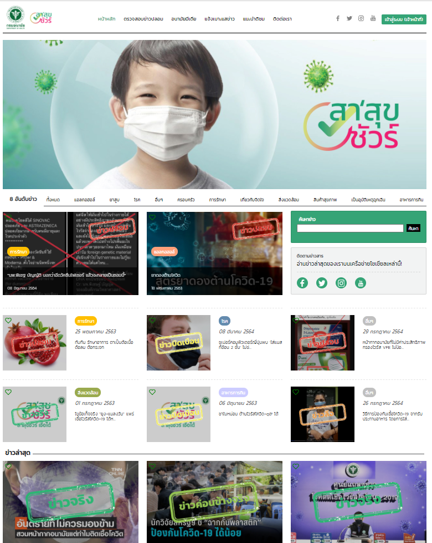
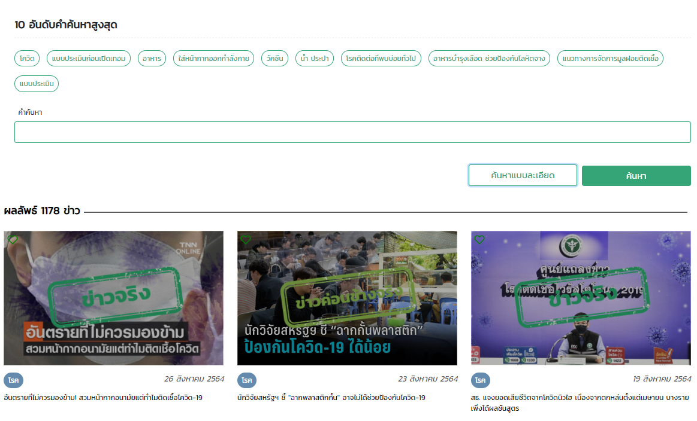
“The health literacy system”
was invented by a Thai government health agency to provide academics from related support departments with information and facts for health news in society during the COVID-19 situation.
Notes:
— In recent years, Managing health news to raise public awareness of accurate information is essential to the quality of life of the people. For this reason, “The health literacy system” was invented and publishing website for Thai people.

Slide 8





System work flow
Visitors
Admin
Academics
Admin
Visitors
Report News
Verify News
Respond News
Validate News
Publish News

Slide 9
As-is system work flow
Visitors
Admin
Academics
Admin
Visitors
Report News
Verify News
Respond News
Validate News
Publish News
- check news
- report news
- categorize news
- hand on news
- respond news
- send back news
- confirm news
- submit news
Rest API: News classification model
Notes:
This is roughly as is system work flow
Firstly, the visitor can check and report news through the website
then web admin will verify, categorize news and hand on to relevant departments.
then the academics will respond the news and send back to admin
after that the news will be confirmed and submitted for publishing on the website.
CLICK
We will focus on verify news stage by creating News classification model as API service integrating with the system.

Slide 10
02
Problem statement
Notes:
For Problem statement section.

Slide 11
Current problem encountered
Each staff has a different decision criteria for classifying news.
It leads to problems in displaying the news or in actual use.
Notes:
What current problem we are encountering is
Each staff has a different decision criteria for classifying news.
which leads to problems in displaying the news on website or in actual use case.

Slide 12
“How could we help reduce human resource in categorizing news in the system.”
Notes:
So “How could we help reduce human resource in categorizing news in the system.”

Slide 13
03
Objective
Notes:
For Our objective is

Slide 14
Objective : Text Classification
News content
News category
น้ำกระเทียมโทนผสมกันนมเปรี้ยวดื่ม ป้องกันเส้นเลือดตีบ
อาหารการกิน (Food)
ยอดดับโควิดในเมียนมา เพิ่ม 2 เท่าในอัตราเร็วสุดในโลก
โรค (Disease)
หากเด็กมีอาการ "เป็นหนุ่มเป็นสาวก่อนวัย" ควรจะดูแลอย่างไร
ครอบครัว (Family)
Notes:
to correctly classify news category that are reported into the system, as shown in this slide.

Slide 15
Objective : Workflow process
Data Preparation &
Data Preprocessing
Exploratory Data Analysis
Model Development
Evaluation
- exported data
- chose columns
- dropped NULL
- removed stop words
- removed punctuation
- tokenized words
- normalized words
Notes:
Our workflow process in model creation is divided into 4 steps
Which are
Data Preparation and preprocessing
Exploratory Data analysis
Model development
And Evaluation
which will be explained hereafter.

Slide 16
04
Data
Notes:
In the Data section

Slide 17
Data
Train data set
7,776 news
(From June 2019 to September 2022)
Data Preparation
2. Test data set
328 news
(From October 2022 to December 2023 )
Notes:
We’va got 2 data sets exported from the database.
First is Train data set, about 7,776 articles. There’s valid information from June 2019 to September 2022
Second is Test data set, 328 articles. There’s valid information from October 2022 to December 2023.

Slide 18
Data : Data Preparation
Train data : 7,776 articles (Jun 2019~ Sep 2022)
Column | Description
Titles <String> | Title of the news
Details <String> | Detail of the news
Publish Date <Date> | The date of the news was published
News Type <String> | 7 categories of news
Notes:
For data preparation
We chose 4 columns from The train data set which are Titles, Details, Publish Date and New Type for training model.

Slide 19
Data : Data Preparation
Test data : 328 articles (Sep 2022 ~ Oct 2023)
Column | Description
Titles <String> | Title of the news
Details <String> | Detail of the news
Publish Date <Date> | The date of the news was published
News Type <String> | 7 categories of news
To predict
Notes:
We chose 3 columns from The test data set which are Titles, Details and Publish Date
And kept the News Type columns to be predicted as a target and evaluate model.

Slide 20
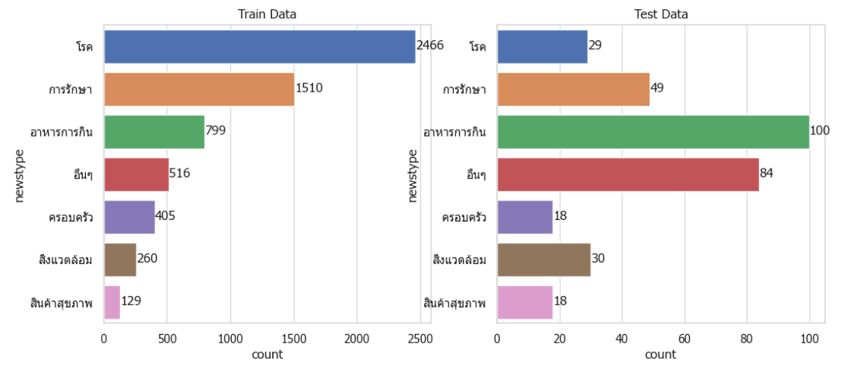
Data : Data Preprocessing
Train data : 6,085 articles
Test data : 328 articles
Dropped NULL
1,691 rows*
Notes:
For Train data: Only 6,085 rows of NewsType column are labelled and so any rows with null value will be dropped.
For Test data: All 328 rows of NewsType column are already completed labelled so it will be used

Slide 21
Data : Data Preprocessing
Stopwords are words that can be removed while the message still conveying the original meaning.
['มี', 'การ', 'ความ’, ‘อันตราย’, ‘แก่ชีวิต'] [‘อันตราย', ‘แก่ชีวิต']
It involves eliminating special characters while still maintaining the main idea of the message.
!"#$%&'()*+,-./:;<=>?@[\]^_`{|}~
Remove Stopwords
Remove Punctuation
Tokenize word is cutting the word by using method to convert the sentence form into words.
[อากาศร้อนจัดในอินเดียคร่าชีวิต]
[อากาศ, ร้อน, จัด, ใน, อินเดีย, คร่าชีวิต]
It is dealing with misspelled words or using the wrong characters by making correct words.
โควิท > โควิด , มะเร็งง > มะเร็ง
รักษLา > รักษา, เ เม่ > แม่
Tokenize words
Normalize words
Notes:
For data preprocessing,
We prepared news data to make them ready for both train and test dataset before training model
By Removed stopword that can be removed without the message still conveying the original meaning
And Removed Punctuation to eliminate special characters while still maintaining the main idea of the message
And Tokenized words by using method to convert the sentence form into words.
And Normalized words to deal with misspelled words or wrong characters by making correct words.

Slide 22
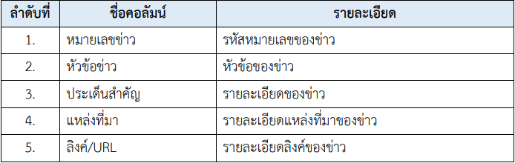
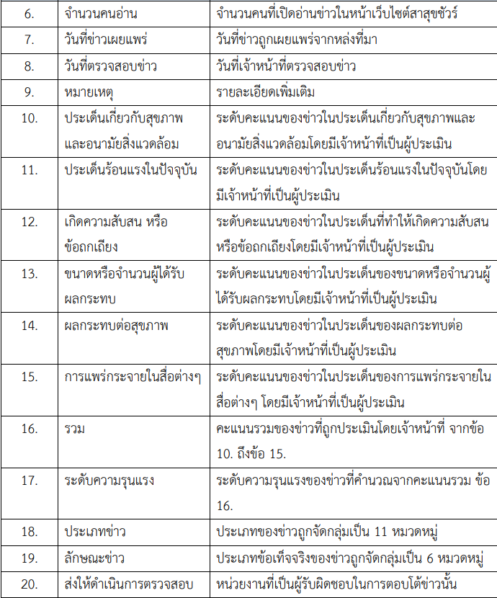
Train data

Slide 23
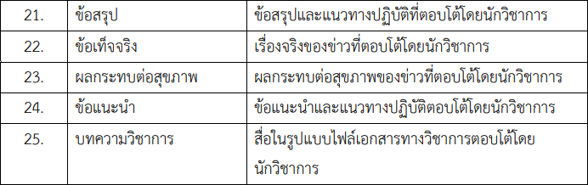
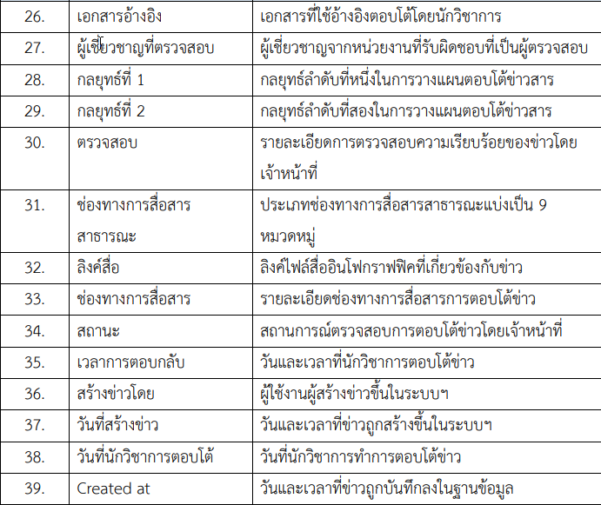
Train data(2)
We've dropped rows of ‘null’ value so only 6,090 of ‘News Type’ are labelled and will be target column.

Slide 24
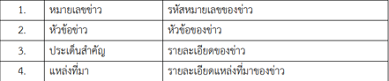
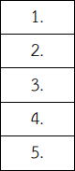
Test data

Slide 25
05
Exploratory Data Analysis
Notes:
In the Exploratory Data Analysis section

Slide 26
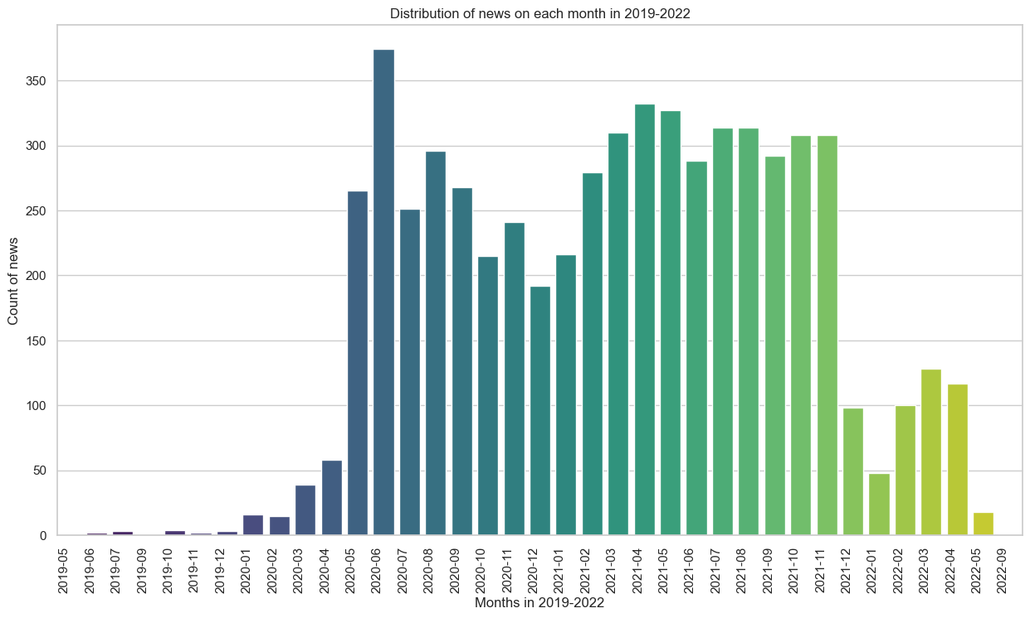
Notes:
We found that
The number of news increased starting in December 2019, when the COVID outbreak began in Wuhan, China, and throughout 2020 and 2021, the number of news continued to increase significantly. This coincided with the time when COVID was spreading around the world.

Slide 27

Notes:
This word could showing the most frequently used words in the news training dataset. which confirms that the number of news related to COVID-19 is the highest in the system. We will also see other related words such as infection, treatment, death or even vaccination which officially in Thailand in the middle of 2021.

Slide 28
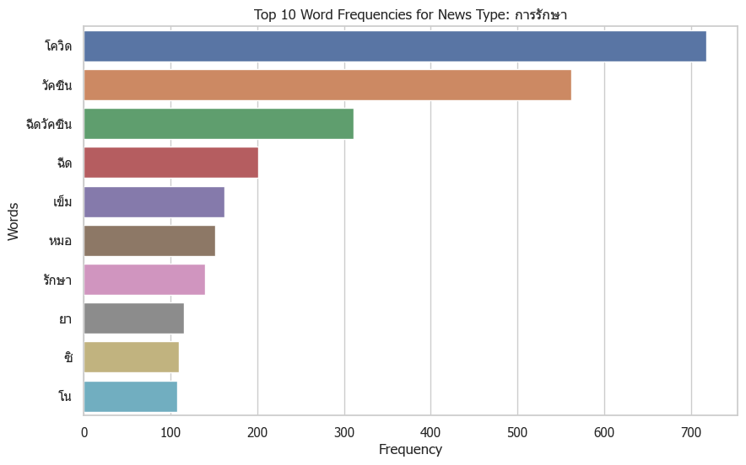

ติดโควิดให้กินยาพารา วิตามินซี โซดามิ้นท์ ฟ้าทะลายโจร รักษาโควิด
ต่างชาติงง คนไทยจ่ายเงินซื้อวัคซีนโควิด19 เอง
Notes:
Next, let's take a look at the most common words in all 7 types of news.
The First category is treatment:
We will see news related to treatment including:
Doctors, medicines, vaccinations, or even brands of vaccines
You can see some examples of the news at the top left. which talks about taking medicine to treat COVID
and ordering vaccines for Thai people

Slide 29
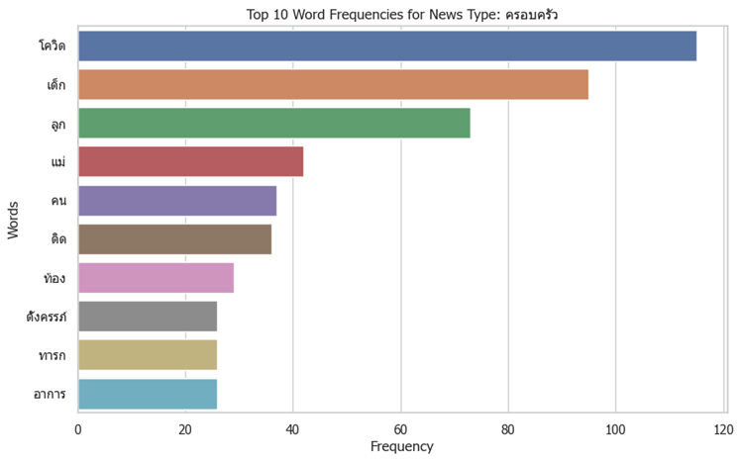

หนูน้อยผื่นขึ้นเห่อเต็มแก้ม หลังญาติขอให้พระเคี้ยวหมากเป่ากระหม่อม แม่เด็กห้ามไม่ทัน
สาวหอบลูกหนี ครอบครัวอึ้งถูกทารุณจนเสียสติ
Notes:
The SECOND category is family:
people child mother family
You can see a preview of the news at the top left. which talks about news about the family

Slide 30
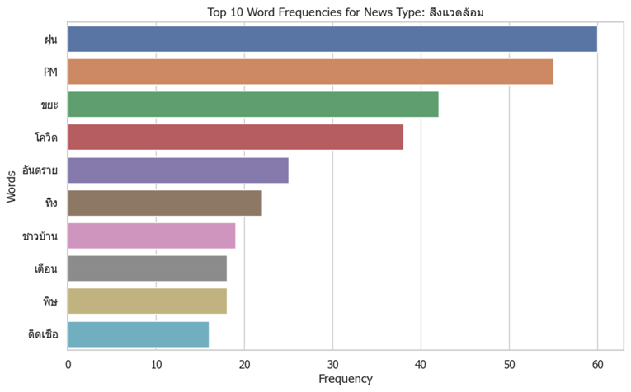

ไฟป่าก่อปัญหาฝุ่นละออง! สารพันปัญหามลพิษที่เกิดจากการเผาป่า
‘ฝุ่น PM 2.5’ ปกคลุม ‘พะเยา’ ส่งผลต่อสุขภาพ
Notes:
The third category is Environment
PM 2.5 dust dangerous
You can see a example of the news at the top left. which talks about news about dust, forest burning, environmental conditions that affect health

Slide 31
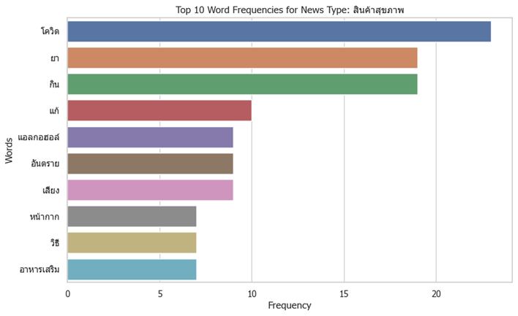

ห้ามกินยากับน้ำอุ่น น้ำหวาน และน้ำผลไม้ เพราะทำให้ยาไม่ละลาย อาจแตกตัวที่กระเพาะ
การใส่หน้ากาก ล้างแอลกอฮอล์ สามารถลดโอกาสการติดและแพร่เชื้อโควิด
Notes:
The fourth category is health product:
Medicine alcohol mask dietary supplement
can see a preview of the news at the top left. which talks about news about medicines medical products and dietary supplements

Slide 32
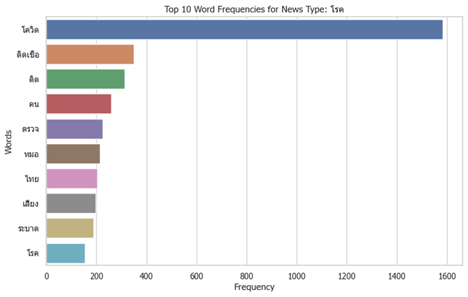

ชายไทยวัย 56 กลับจากอินเดีย เสียชีวิต ตรวจพบกล้ามเนื้อหัวใจขาดเลือด ไม่ได้จากโควิด 19
ไวรัสที่ไข้หวัดธรรมดาจะช่วยให้เซลล์ในร่างกายคนเราไม่ติดเชื้อไวรัสก่อโรคโควิด 19
Notes:
The fifth category is disease :
disease infection covidYou can see a preview of the news at the top left. which talks about news about disease

Slide 33
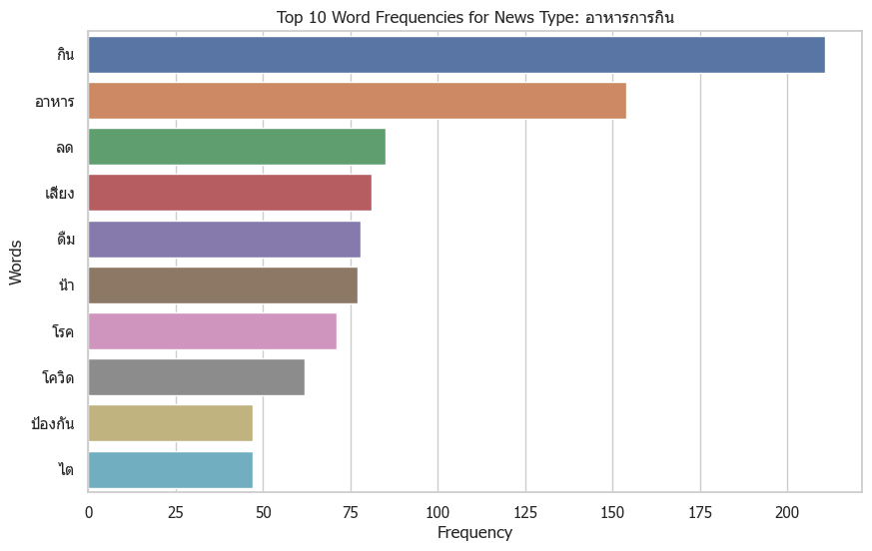

“เชื้อดื้อยา”จากฟาร์มสัตว์สู่คน : กินหรือไม่กินเนื้อสัตว์ ก็เสี่ยงติดเชื้อดื้อยา
กินหมูดิบ เสี่ยงโรคไข้หูดับ จริงหรือ? อาการหูดับเป็นอย่างไร
Notes:
The sixth category is Food :
Eating food disease
You can see a preview of the news at the top left. which talks about news about food

Slide 34
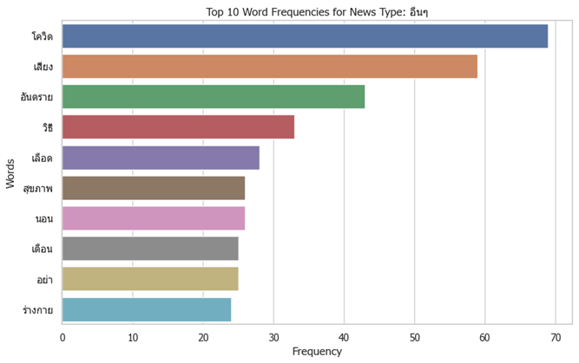

เผย 6 เหตุผล จำเป็นต้องผ่าฟันคุดออก ไม่อย่างนั้นอาจเป็นอันตรายกับช่องปาก
น้ำยาทาเล็บมีสารเคมีหลายชนิดก่อให้เกิดอันตราย ใช้ทาเล็บบ่อยๆ เสี่ยงเป็นมะเร็ง
Notes:
The seventh category is etc:
You will be able to see many words that do not fall into any category.
You can see a preview of the news at the top left. which talks about Various news that is dangerous to health

Slide 35

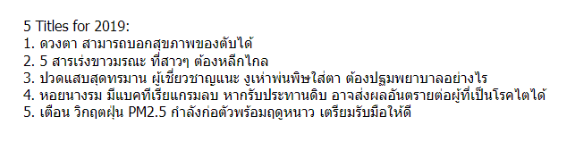

Slide 36

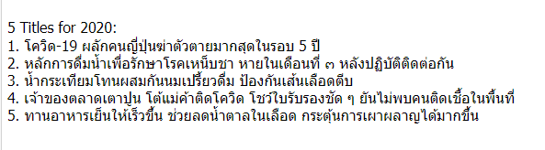

Slide 37

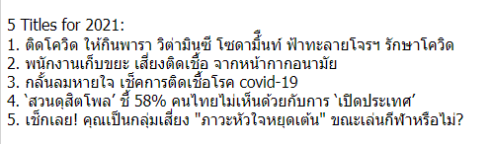

Slide 38

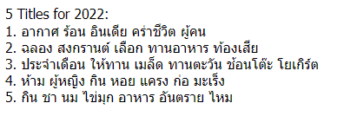

Slide 39
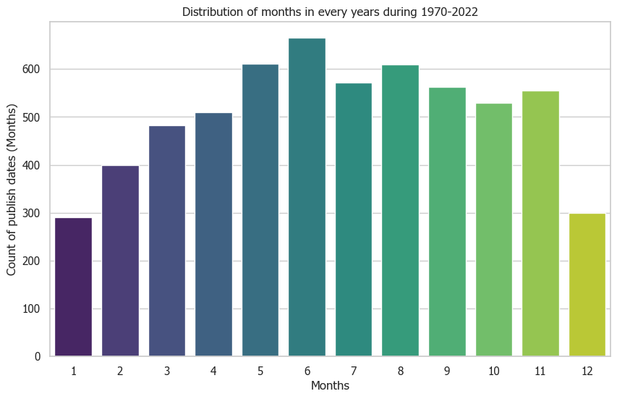
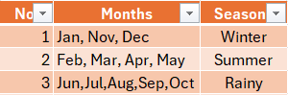

Slide 40

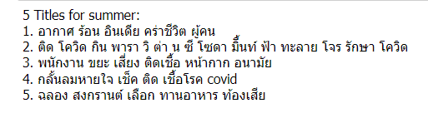

Slide 41

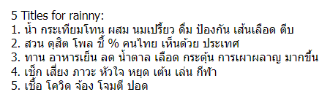

Slide 42

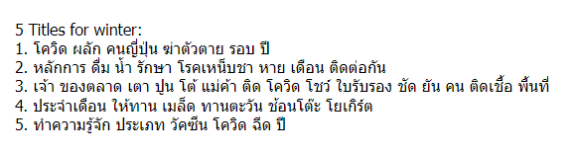

Slide 43
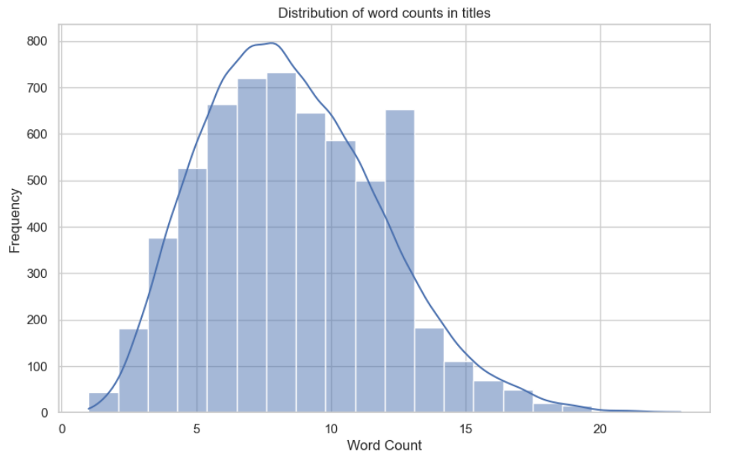
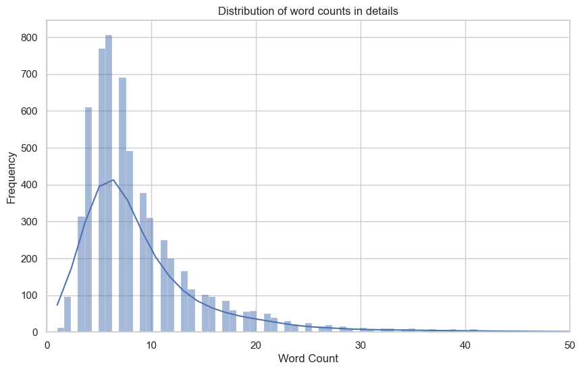

Slide 44
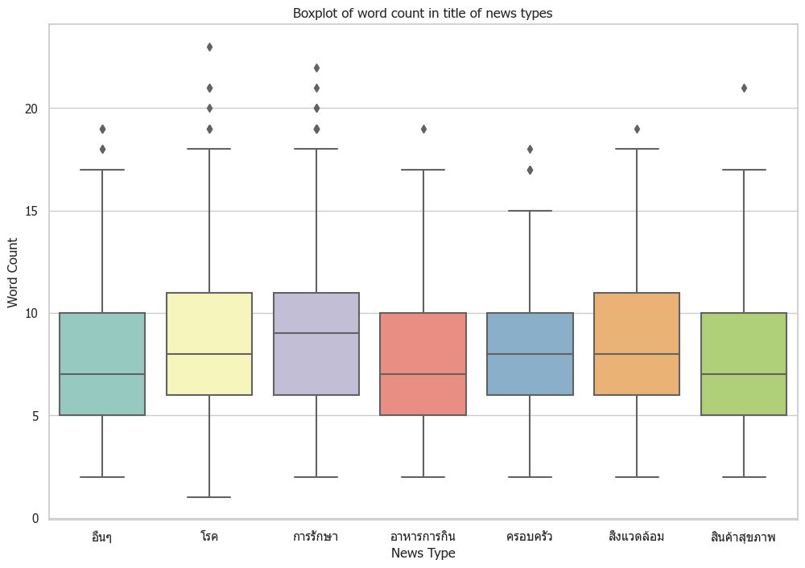
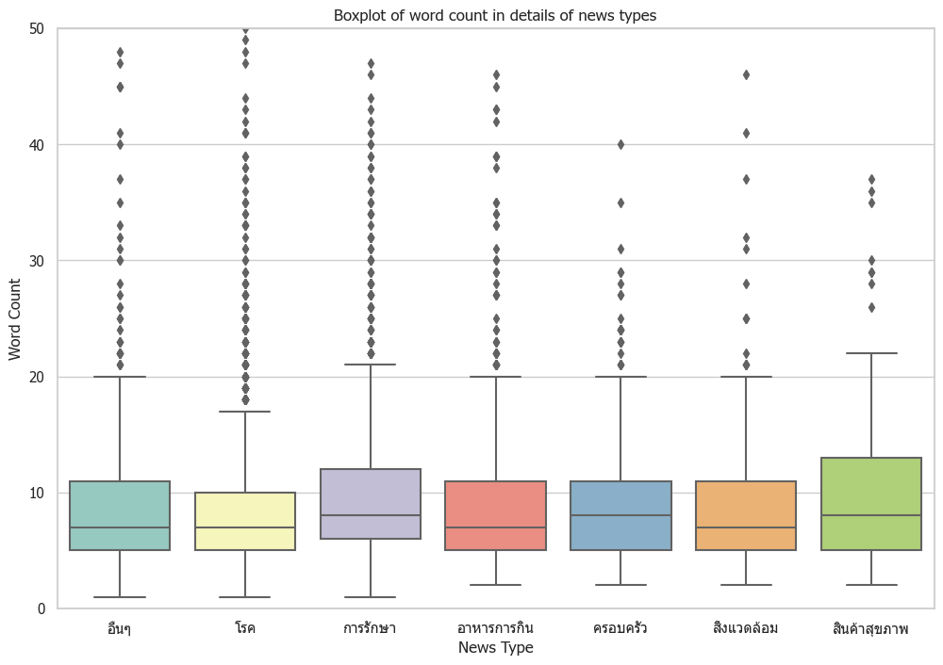

Slide 45
06
Modeling

Slide 46
Vectorizer
CountVectorizer
Classifier Model
LogisticRegression
Technique
Class Weight
Hyper Parameters
C=1, Max inter=10, CV=5

Slide 47

Score Type | Best Score
Accuracy Score | 0.61
Precision Score | 0.58
Recall Score | 0.60
F1 Score | 0.57
รูปถ่ายนี้ โดย ไม่ทราบผู้เขียน ลิขสิทธิ์ของ CC BY-NC

Slide 48
07
Error Analysis

Slide 49
Error analysis
No. | Title | Actual Class | Predict Class | Status
1. | 5 เครื่องดื่มที่ไม่ควรกินคู่กับยา | อาหารการกิน | สินค้าสุขภาพ | Misclassified
2. | ฝุ่น PM 2.5 ทำให้อ้วนขึ้นได้ | สิ่งแวดล้อม | อื่นๆ
3. | Glassy Mix รักษาตาพร่ามัว | สินค้าสุขภาพ | การรักษา
4. | อ้างเป็นหมอห้ามฉีดวัคซีนเด็ก | การรักษา | ครอบครัว
5. | พาลูกฝังยาคุม บอกเพื่อนภูมิใจ | ครอบครัว | สินค้าสุขภาพ
6. | เครียด วิตกกังวลเสี่ยงโรคแพนิค | โรค | ครอบครัว
7. | โรคติดน้ำแข็ง ขาดธาตุเหล็ก | อื่นๆ | โรค
Notes:
From error analysis table :
We will be able to see examples of all types of news being mispredicted.
From the first news to news aboutDrinks that should not be drunk with medicineFrom this news,
the word eat should be in food.
And the word medicine should be in the health product:
From the second news is news about
Dust pm 2.5 makes you fat.
the word PM2.5 should be in ….
And the word fat should be in the etc.
From the third news is news about
Glassy Mix glasses treat blurred vision.
the word Glassy Mix product should be in health product
And the word treat should be in the treatment,

Slide 50
08
Conclusion
Notes:
An the last section is conclusion …

Slide 51
Conclusion
The news classification model can be integrated into the health literacy system to help staff decide on the correct type of news and reduce problems in publishing the information on a website or in actual use.
Limitation
The data used for model is all health-related news. Therefore, each type of news is very related so very challenging to classify clearly.
Some categories have a certain amount of news, much less than other types (Imbalance Class), leading to the model's accuracy.
Most of the news data used occurred during the COVID-19 outbreak, causing the news characteristics to be similar and thus affecting the model's accuracy.
Suggestion
Gathering more news from other sources that have the same classification to train the model. This will help increase the accuracy of the news classification model.
Adding a system allows the model to learn recent news regularly to increase model accuracy.
Adding a function to trim words frequently appearing in multiple categories to get more unique keywords from each type of news.

Slide 52
Thank you

